Slide 1
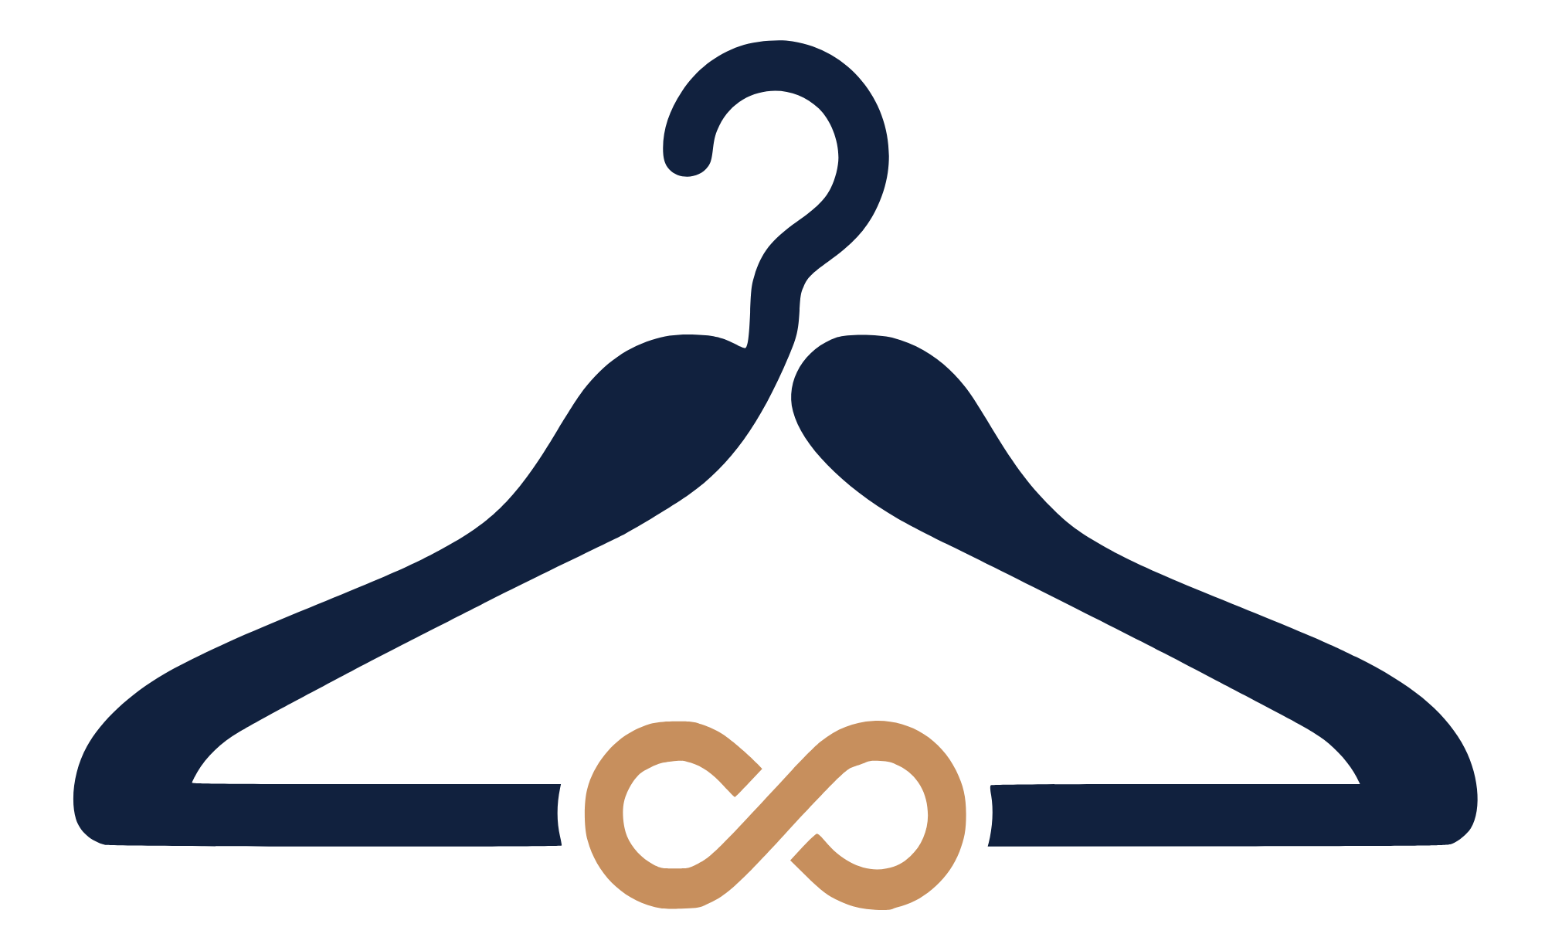
Drssed
Wear the moment. Share the wardrobe.

Slide 2
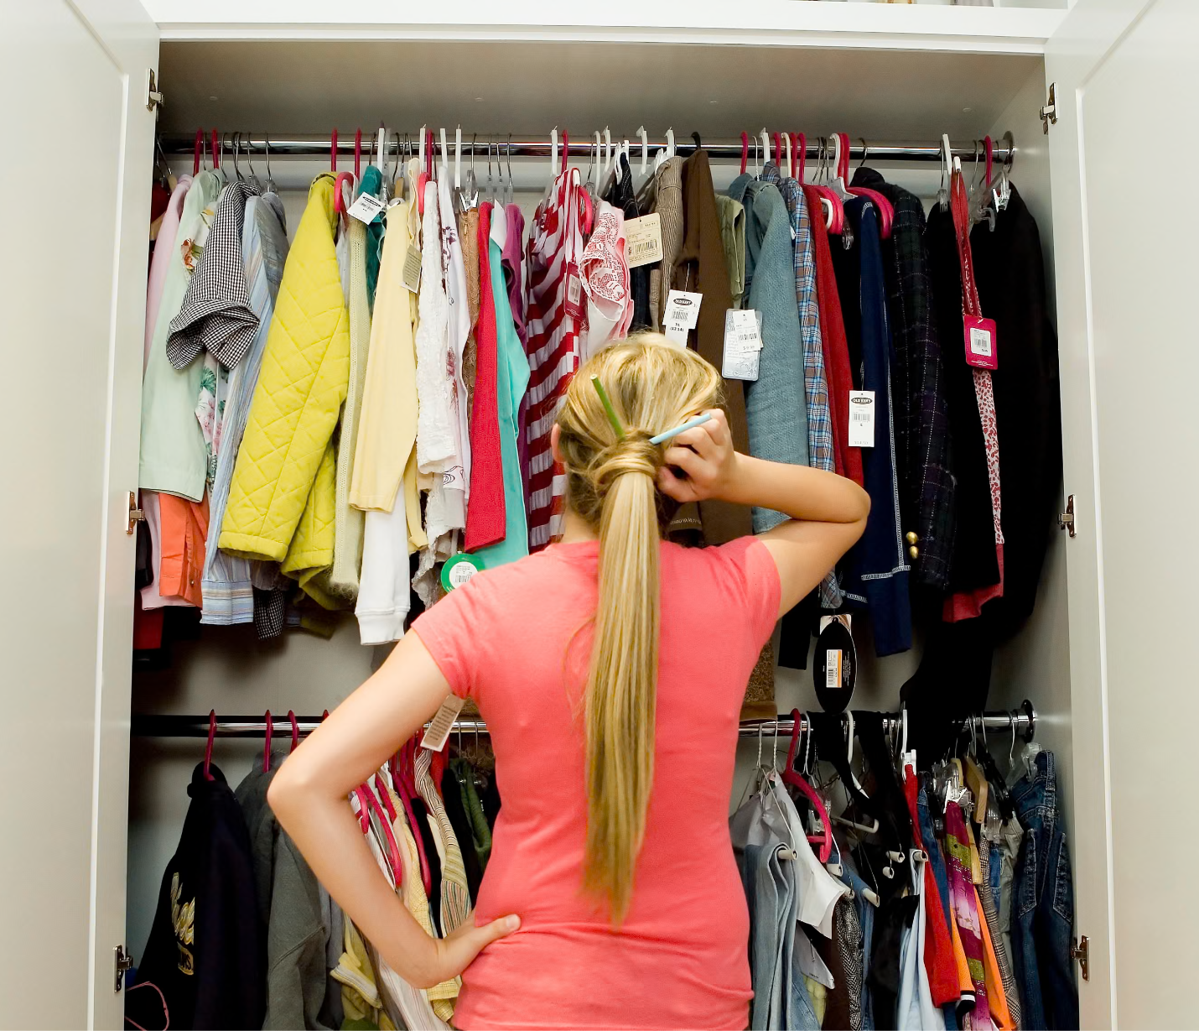
The Problem
Looking great shouldn't cost a fortune
Formal wear is worn once, then forgotten
Buying is expensive. Owning is wasteful.
No solution exists in Bulgaria

Slide 3
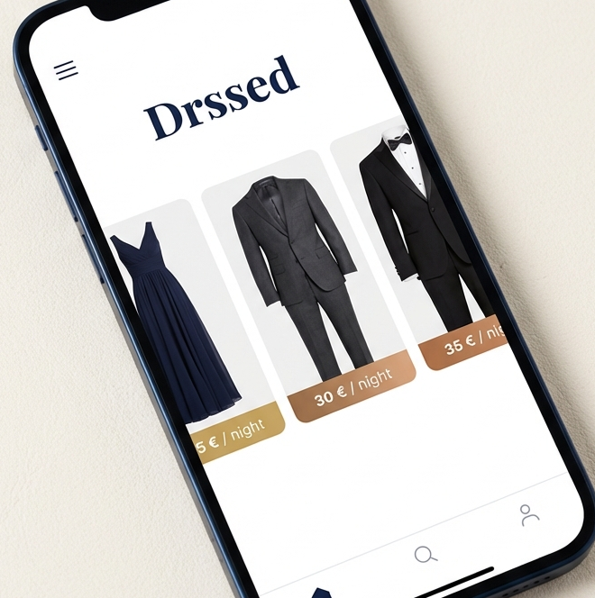
Meet Drssed
A platform that connects people who have formal wear with people who need it for a night.

Slide 4
How it Works?
01
02
03
List your outfit
Browse & book
Wear & return
Take a few photos, set your price, and publish.
Find the perfect outfit and reserve it.
Wear it, return it, get paid.

Slide 5



Why Invest?
First Mover
Growing Market
Sustainability
First P2P fashion rental platform in Bulgaria.
The European fashion rental market is expanding rapidly.
Consumers today choose brands that reduce waste.

Slide 6

Why Work at Drssed?
Build from zero
Purpose-driven
Ground floor

Slide 7
Get in Touch
www.drssed.bg | hello@drrsed.bg +359 88 770 1234 | @drssed.bg

Slide 8
Thank You

